Slide 1
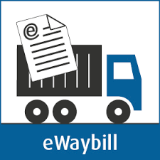
By:

Slide 2
Features
Introduced under GST Act, vide rule No 138
Electronic environment
One document- nationwide acceptability
Easy to operate
Flexible
Replaces “ Road Permits”
Uninterrupted transport
Less papers to be carried
Online verification
Agile

Slide 3
Commencing from
Interstate - 1st February 2018
Intrastate: Date to be notified by each state: Latest date to start : 1st June 2018
Maharashtra – Not applicable till 30th April (Notification No; Notification No. 3A/2018–State Tax )

Slide 4
Modus operandi
Form EWB - 01
PART A
Who...
Every registered person who causes the movement of goods. Ecommerce operator in case of supply through e-commerce.
When...
Before movement of goods.
Value of goods exceeds INR 50,000/- in all cases other than interstate movement for Job Work.
Interstate movement for Job work: E-way bill to be generated irrespective of value of the consignment
E-Way bill can be generated even if value of consignment is less than INR 50,000- Optional

Slide 5
Modus operandi
Form EWB - 01
In case of Air / Train / Sea
PART B
Who
When...
Before movement of goods.
Value of goods exceeds INR 50,000/- in all cases other than interstate movement for Job Work.
Interstate movement for Job work: E-way bill to be generated irrespective of value of the consignment
E-Way bill can be generated even if value of consignment is less than INR 50,000- Optional

Slide 6
Key points....
Consignment value is less than INR 50,000/-: No E-way bill required (optionally can be generated)- Means no Part A & Part B required to be filled
If goods are handed over to transporter for further movement: & Distance between consigner ‘s/ supplier’s place of business & transporter’s place of business is <10 Kms & within same state : Part B may not be filled in
If goods are handed over to transporter for further movement: & Distance between, transporter’s place of business and consignee’s place of business <10 Kms & within same state : Part B may not be filled in
If Conveyance is changed during the transport: Part B needs to be updated before change by transporter / person who filled Part A

Slide 7
Key points....
E-Way bill can be cancelled within 24 hours from the time of generation, if goods are not transported or are not transported as per EWB , provided goods are not verified in transit.
E-Way bill needs to be accepted by counter party ( Consigner / Consignee) within 72 hours of generation on common portal, else it is assumed to be accepted
Validity:
Under circumstances of an exceptional nature, the goods cannot be transported within the validity period of the e-way bill, the transporter may generate another e-way bill after updating the details in Part B of FORM GST EWB-01.
The e-way bill generated under this rule or under rule 138 of the Goods and Services Tax Rules of any State shall be valid in every State and Union territory

Slide 8
Key points....
The person in charge of a conveyance shall carry—
(a) the invoice or bill of supply or delivery challan, as the case may be; and
b) a copy of the e-way bill or the e-way bill number, either physically or mapped to a Radio Frequency Identification Device embedded on to the conveyance in such manner as may be notified by the Commissioner.
A registered person may obtain an Invoice Reference Number from the common portal by uploading, on the said portal, a tax invoice issued by him in FORM GST INV-1 and produce the same for verification by the proper officer in lieu of the tax invoice and such number shall be valid for a period of thirty days from the date of uploading.
Where the registered person uploads the invoice , the information in Part A of FORM GST EWB-01 shall be auto-populated by the common portal on the basis of the information furnished in FORM GST INV-1.
The Commissioner may, by notification, require a class of transporters to obtain a unique Radio Frequency Identification Device and get the said device embedded on to the conveyance and map the e-way bill to the Radio Frequency Identification Device prior to the movement of goods.
The Vehicle may be stopped at any location by the authorized officer. If so stopped, the verification report is updated in draft on portal within 24 hours and the final report is updated within 3 days.
Where a vehicle has been intercepted and detained for a period exceeding thirty minutes, the transporter may upload the said information in FORM GST EWB-04 on the common portal

Slide 9
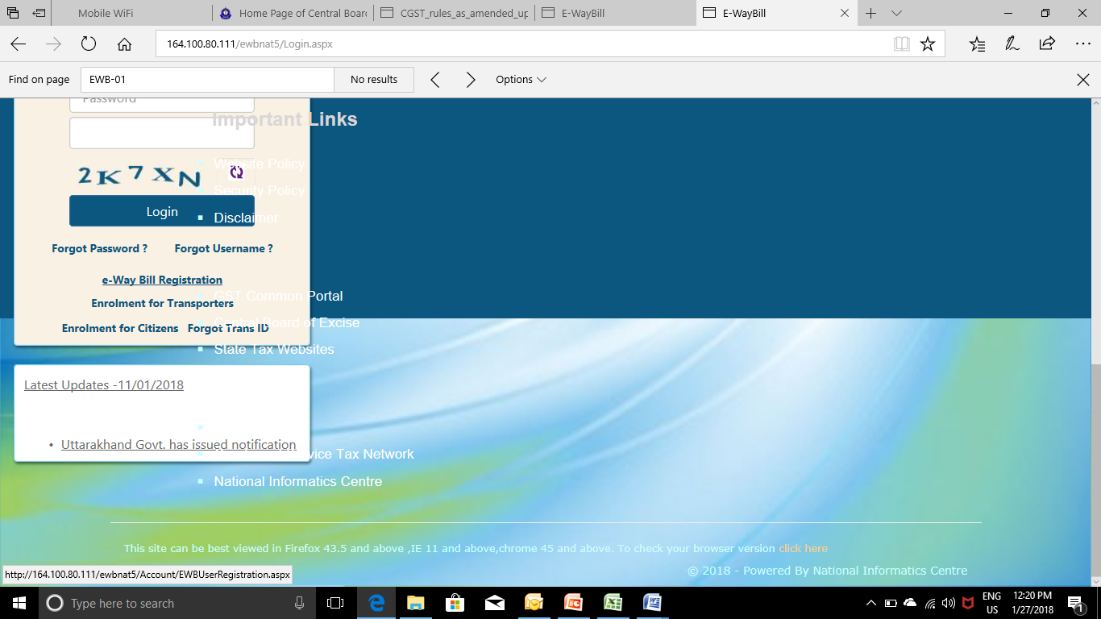
E-Way Bill preparation....
Step I : Create log in id

Slide 10
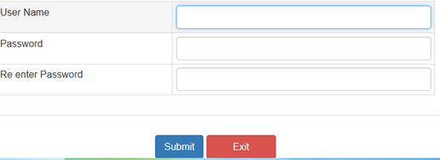
E-Way Bill preparation....
Step II : Create log in id
Step III : Post entering GSTIN, details of the taxpayers are displayed. Clock on send OTP.
An OTP will be sent on registered mobile number and email. Enter the OTP & click on verify OTP
Step IV : Create log in and password

Slide 11
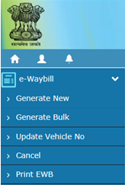
E-Way Bill preparation....
Step IV : Create E-Way Bill – PART A

Slide 12
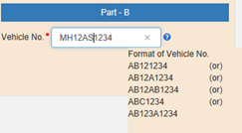
E-Way Bill preparation....
Step IV : Create E-Way Bill – PART B

Slide 13
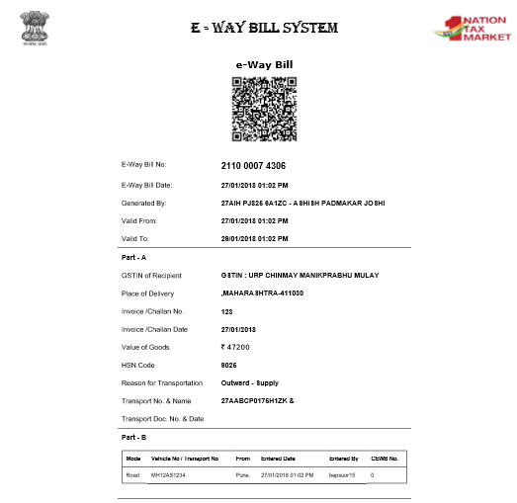
E-Way Bill....

Slide 14
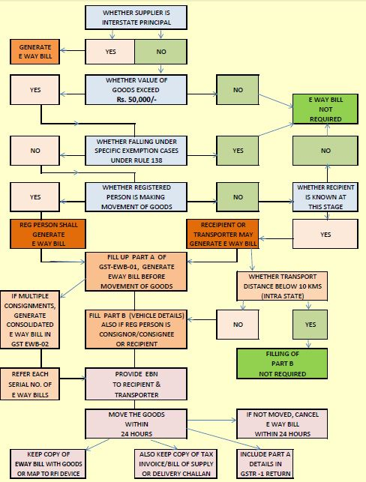
Procedure of E Way Bill

